Slide 1
Compiler Construction
Lecture 3

Slide 2
Topics Covered in Lecture 2

Slide 3
Source Code
Lexical Analyzer
Syntax Analyzer
Symbol
Table
Manager
Semantic Analyzer
Error
Handler
Intermediate Code Generator
Code Optimizer
Code Generator
Object Code

Slide 4
Lexical Analyzer
(Part One)

Slide 5
Lexical Analysis
INPUT: sequence of characters
OUTPUT: sequence of tokens
Next_char()
Next_token()
Input
Input
Input
Input
Scanner
Scanner
Scanner
Parser
character
token
Symbol
Table
A lexical analyzer is generally a subroutine of parser
A symbol table is a data structure containing a record of each identifier along with its attributes

Slide 6
Role of Lexical Analyzer
Removal of white space
Removal of comments
Recognizes constants
Recognizes Keywords
Recognizes identifiers
Correlates error messages with the source program

Slide 7
Removal of white space
By white space we mean
  Blanks
  Tabs
  New lines
Why ?
  White space is generally used for formatting source code.
A = B + C
Equals
A=B+C

Slide 8
Removal of white space
Learn by Example
  // This is beginning of my code
  int A;
  int B = 2;
  int C = 33;
  A = B + C ;
  /* This is
  end of
  my code
  */

Slide 9
Removal of white space
Learn by Doing
  // This is beginning of my code
  int A ;
  A = A
  *
  A
  ;
  /* This is
  end of
  my code
  */

Slide 10
Removal of comments
Why ?
  Comments are user-added strings which do not contribute to the source code
Example in Java
  // This is beginning of my code
  int A;
  int B = 2;
  int C = 33;
  A = B + C ;
  /* This is
  end of
  my code
  */
Means nothing to the program
Means nothing to the program

Slide 11
Recognizes constants/numbers
How is recognition done?
  If the source code contains a stream of digits coming together, it shall be recognized as a constant.
Example in Java
  // This is beginning of my code
  int A;
  int B = 2 ;
  int C = 33 ;
  A = B + C ;
  /* This is
  end of
  my code
  */

Slide 12
Recognizes keywords
Keywords in C and Java
  If , else , for, while, do , return etc
How is recognition done?
  By comparing the combination of letters with/without digits in source code with keywords pre defined in the grammar of the programming language
  Example in Java
  int A;
  int B = 2 ;
  int C = 33 ;
  If ( B < C )
  A = B + C ;
  else
  A = C - B
Considered a keyword if character sequence
I
N
T
Considered a keyword if character sequence
I 2. F
Considered a keyword if character sequence
E 2. L 3.S 4.E

Slide 13
Recognizes identifiers
What are identifiers ?
  Names of variables, functions, arrays , etc
How is recognition done?
  If the combination of letters with/without digits in source code is not a keyword, then compiler considers it as an identifier.
Where is identifier stored ?
  When an identifier is detected, it is entered into the symbol table
Example in Java
  // This is beginning of my code
  int A;
  int B2 = 2 ;
  int C4R = 33 ;
  A = B + C ;
  /* This is
  end of
  my code
  */

Slide 14
Correlates error messages with the source program
How ?
  Keeps track of the number of new line characters seen in the source code
  Tells the line number when an error message is to be generated.
Example in Java
  This is beginning of my code
  int A;
  int B2 = 2 ;
  int C4R = 33 ;
  A = B + C ;
  /* This is
  end of
  my code
  */
Error Message at line 1

Slide 15
Errors generated by Lexical Analyzer
Illegal symbols
  =>
Illegal identifiers
  2ab
Un terminated comments
  /* This is beginning of my code

Slide 16
Learn by example
  // Beginning of Code
  int a char } switch b[2] =;
  // end of code
No error generated
Why ?
It is the job of syntax analyzer

Slide 17
Terminologies
• Token
  – A classification for a common set of strings
  – Examples:
  Identifier, Integer, Float, LeftParen
• Lexeme
  – Actual sequence of characters that matches a pattern and has
  a given Token class.
  – Examples:
  Identifier: Name, Data, x
  Integer: 345, 2, 0, 629
Pattern
  – The rules that characterize the set of strings for a token
  – Example:
  Integer: A digit followed or not followed by digits
  Identifier: A character followed or not followed by characters or digits

Slide 18
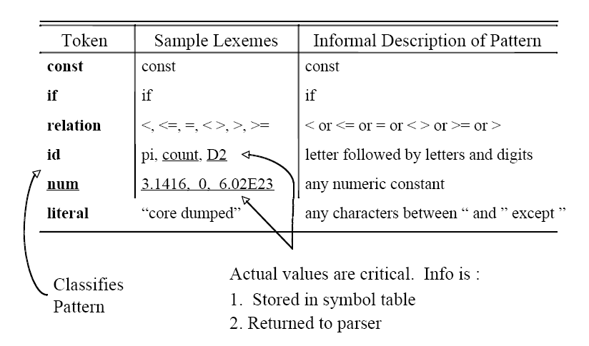

Slide 19
Learn by Example:
Input string: size := r * 32 + c
Identify the <token ,lexeme> pairs
<id, size>
<assign, :=>
<id, r>
<arith_symbol, *>
<integer, 32>
<arith_symbol, +>
<id, c>

Slide 20
Learn by Doing
Input string:
position = initial + rate * 60
Identify the <token ,lexeme> pairs

Slide 21
Lets Revise!

Slide 22
Lexical Analysis
Next_char()
Next_token()
Input
Scanner
Parser
character
token
Symbol
Table

Slide 23
Role of Lexical Analyzer
Removal of white space
Removal of comments
Recognizes constants
Recognizes Keywords
Recognizes identifiers
Correlates error messages with the source program

Slide 24
Terminologies
• Token
  –Identifier, Integer, Float, LeftParen
• Lexeme
  – Identifier: Name, Data, x
  Integer: 345, 2, 0, 629
Pattern
  – Example:
  Integer: A digit followed or not followed by digits
  Identifier: A character followed or not followed by characters or digits

Slide 25
Homework
Identify the <token ,lexeme> pairs
For ( int x= 0; x<=5; x++)
B= (( c + a) * d ) / f
While ( a < 5 )
a= a+1
Char MyCourse[5];
if ( a< b)
a=a*a;
else
b=b*b;

Slide 26
Assignment-1
Write a program in C++ or Java that reads a source file and performs the followings operations:
Removal of white space
Removal of comments
Recognizes constants
Recognizes Keywords
Recognizes identifiers
Due Date: 15th Oct, 2021

